Slide 1
SOUTH AFRICA GIFTS CATALOG 2025
Branded merchandise
Corporate & promotional gifts
Sustainable giveaways
Trendy, creative, innovative
See 2025 catalogue

Slide 2
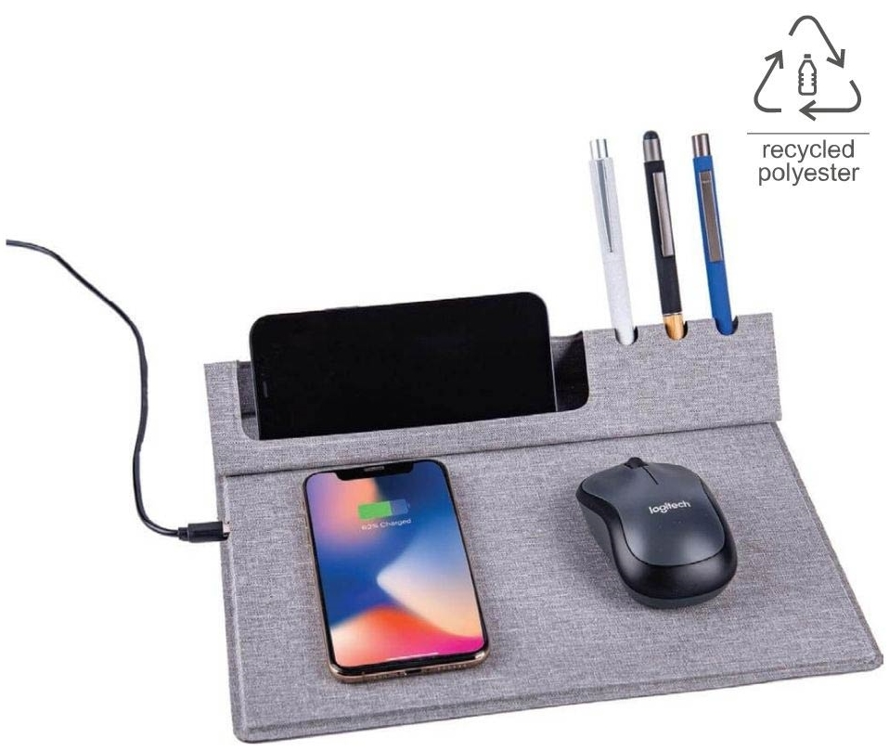
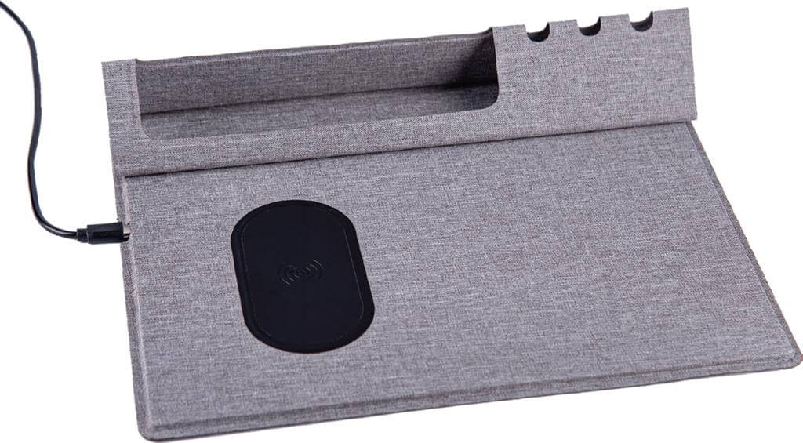
Vani Mouse Pad & Desk Organizer
Eco Friendly RPET Material
10 Watts Wireless Charger
With Mouse pad, Desk Stand
Elegant Fabric gives a Rich appearance
Folds completely, hence a Travel-friendly accessory
Quantity | Unit Price
100 | R
250 | R
500 | R
Notes:
ITWC 154

Slide 3
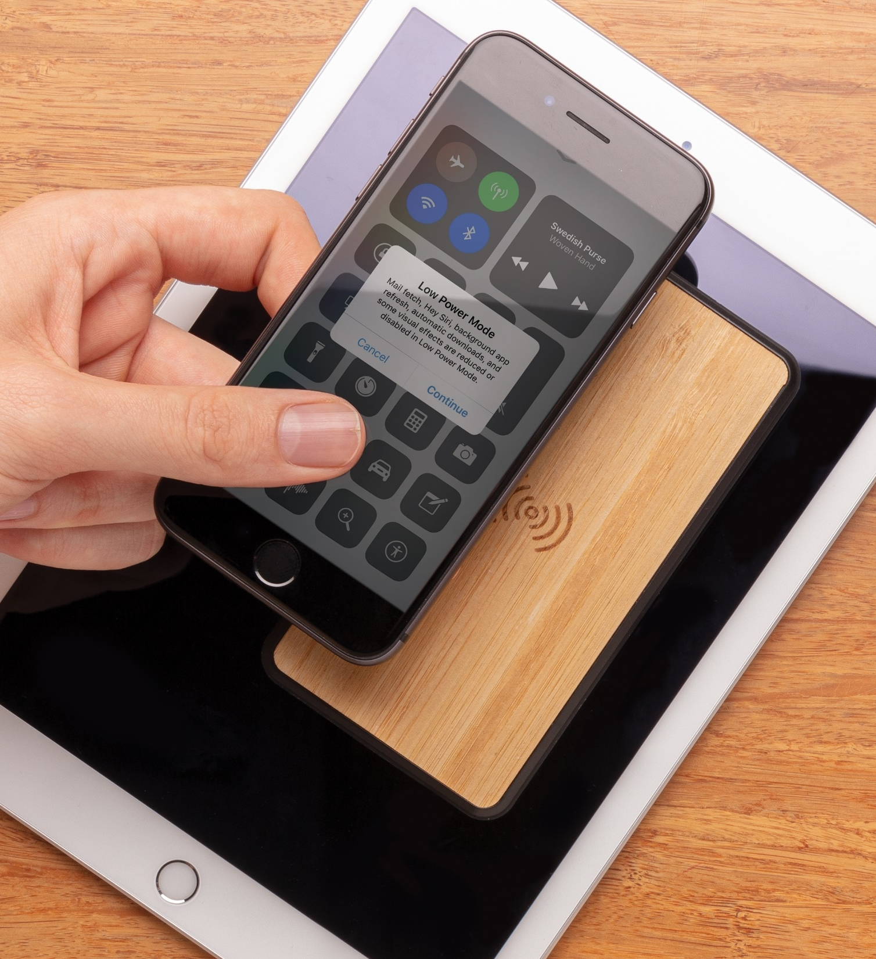
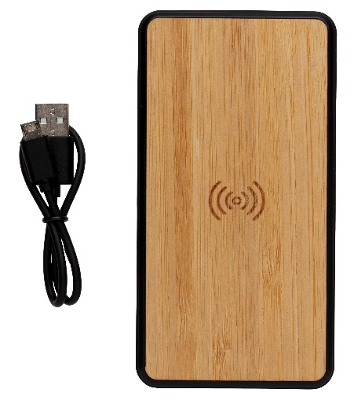
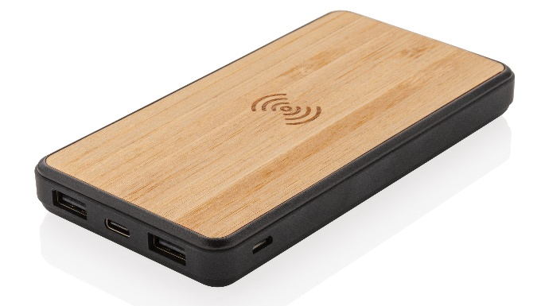
Askas Bamboo 8000mAh Wireless Powerbank
Treated with Biomaster Antimicrobial Technology from the UK
FSC Certified Bamboo
Fashion 8000 mAh Wireless Powerbank
Quantity | Unit Price
100 | R
250 | R
500 | R
Notes:
ITPB 837

Slide 4
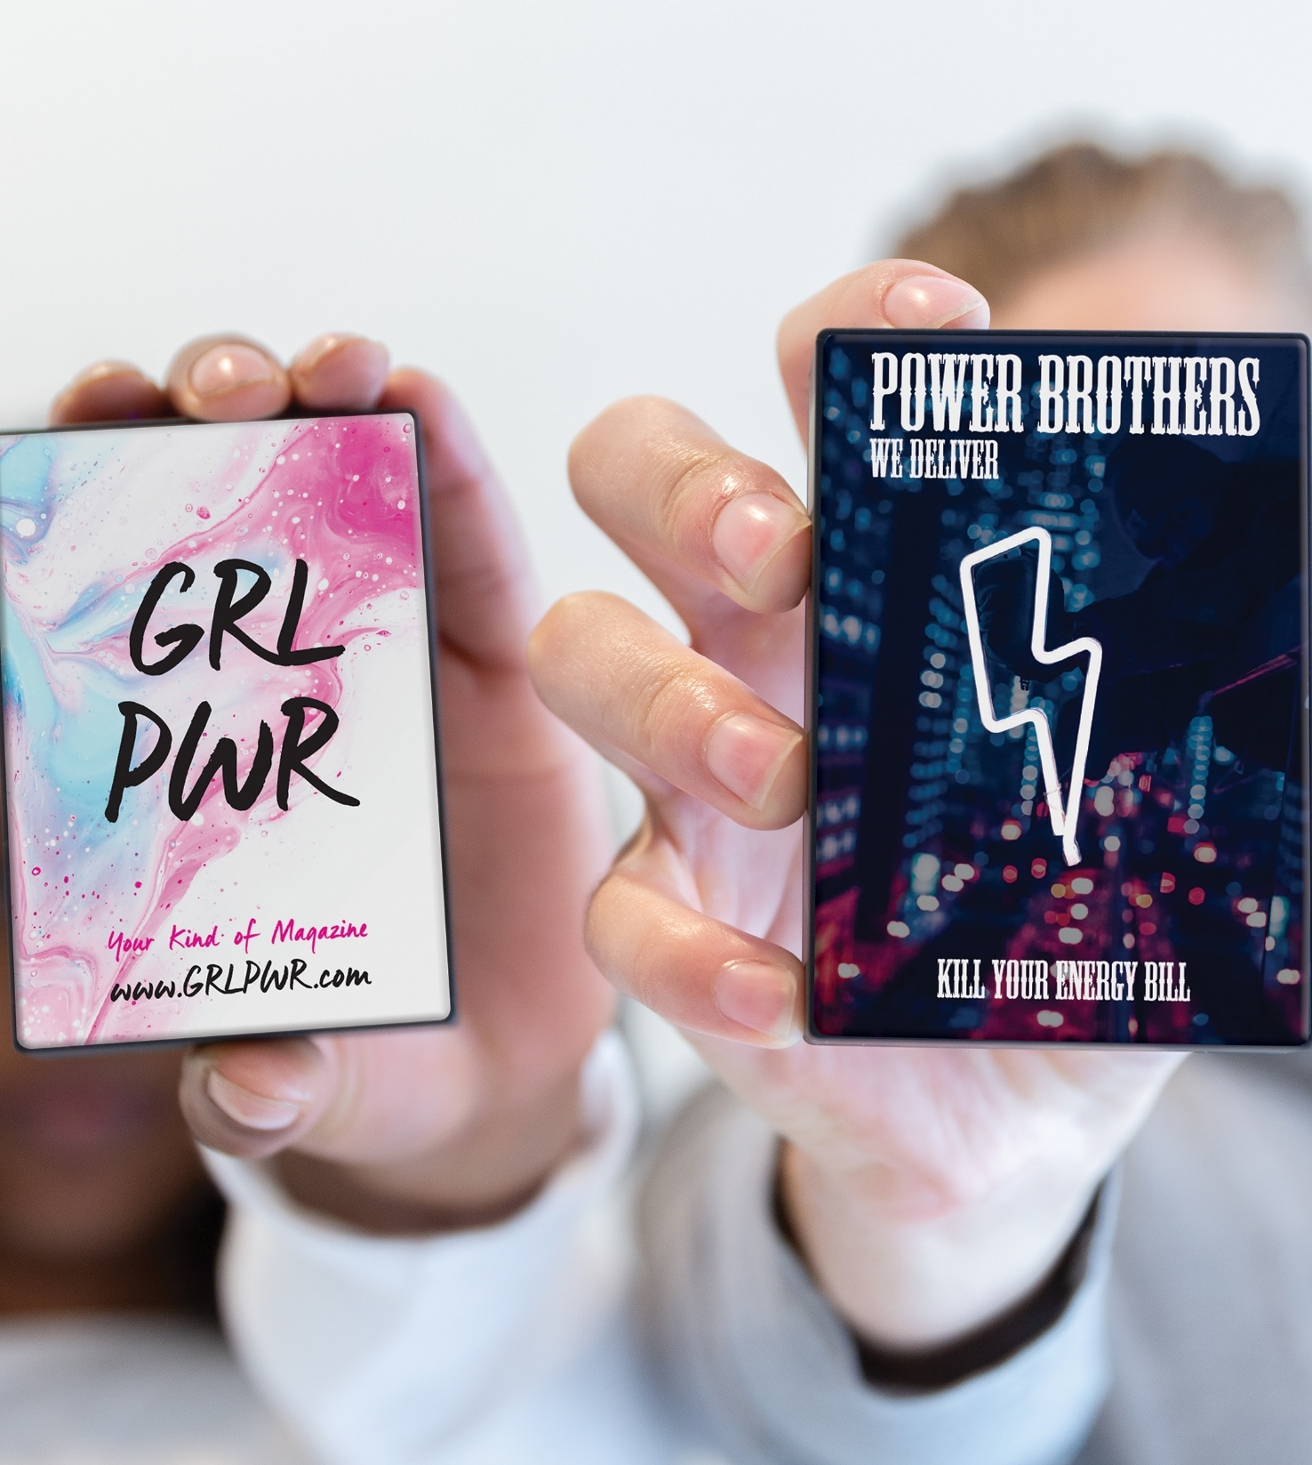
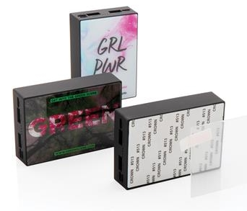
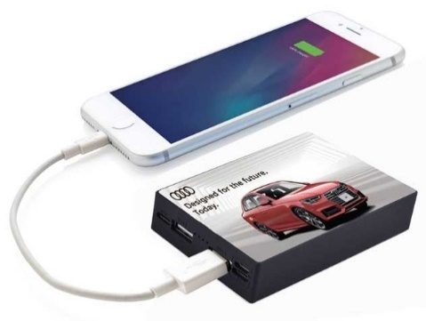
Rodez Tempered Glass 10,000mAh Powerbank
Excellent BRing Space on Tempered Glass Surface
Latest Type-C Input & Output
Capacity : 10,000 mAh
Quantity | Unit Price
100 | R
250 | R
500 | R
Notes:
ITPB 823

Slide 5
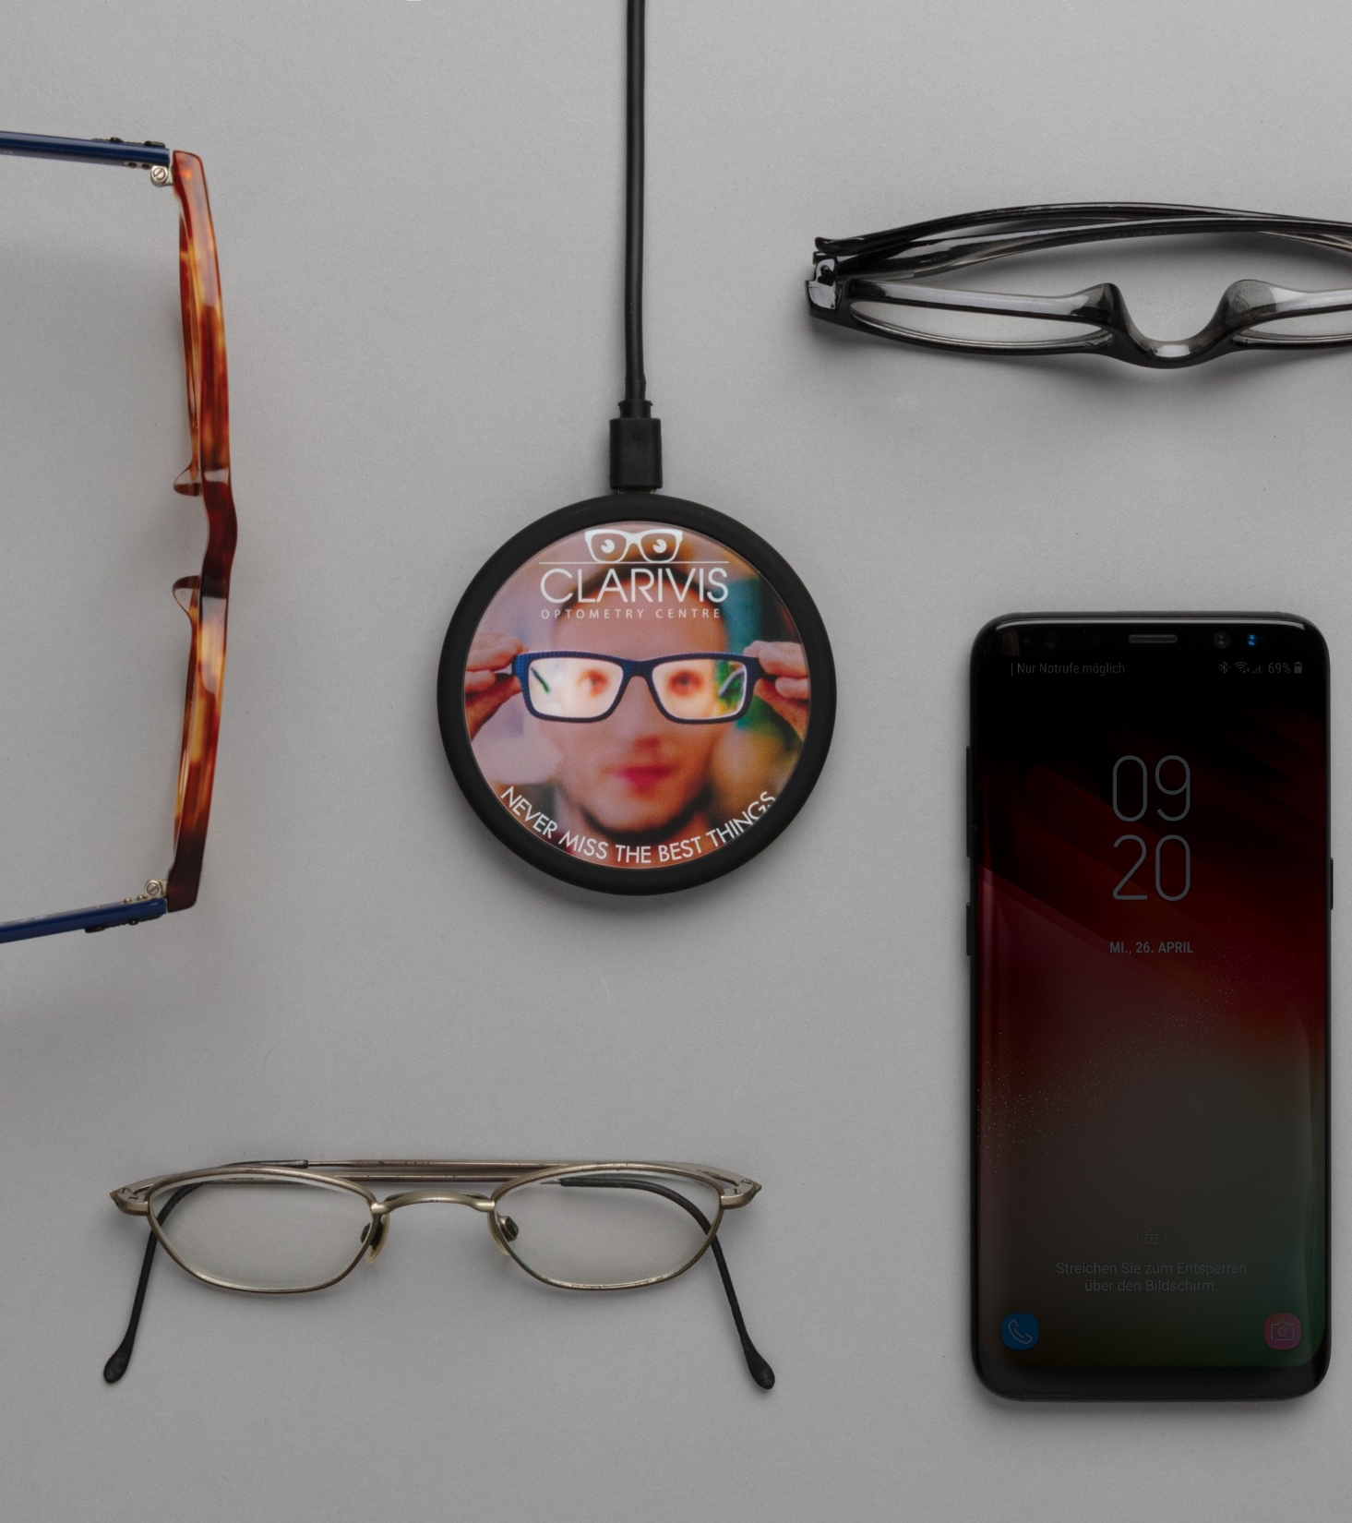
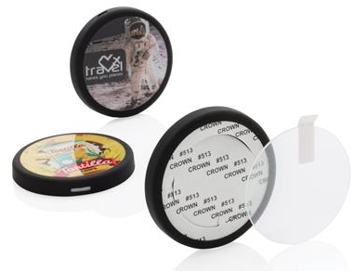
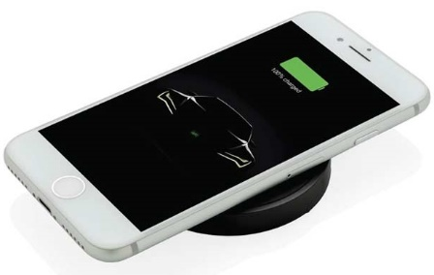
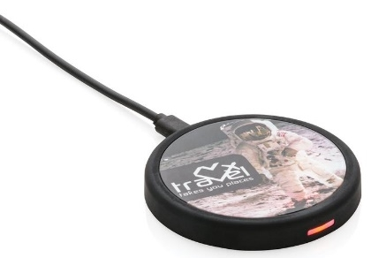
Rennes 5W Wireless Charger
Excellent BRing Space on Scratch-Proof Tempered Glass Surface
Wireless Output: 5W
Smooth Rubberised Surface
Quantity | Unit Price
100 | R
250 | R
500 | R
Notes:
ITWC 204

Slide 6
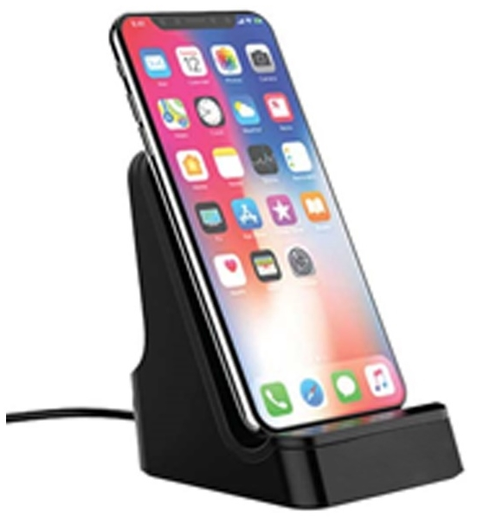
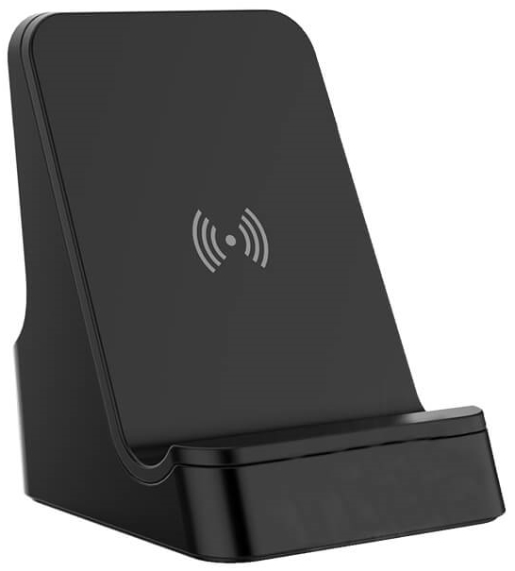
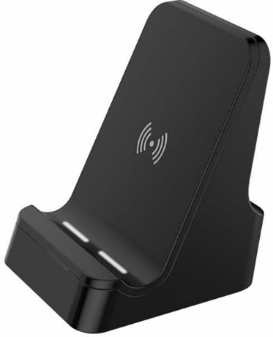
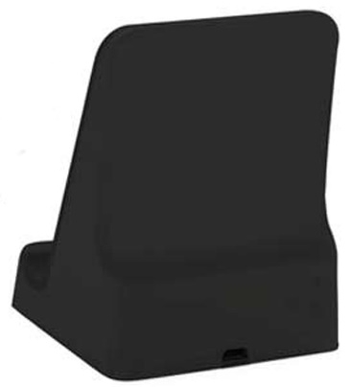
Corinto 5W Wireless Charger With Light Up Logo
5 WATT Wireless Charger
Including 100 cm Micro USB Cable
Light-Up Logo When Engraved
Quantity | Unit Price
100 | R
250 | R
500 | R
Notes:
ITWC 203

Slide 7
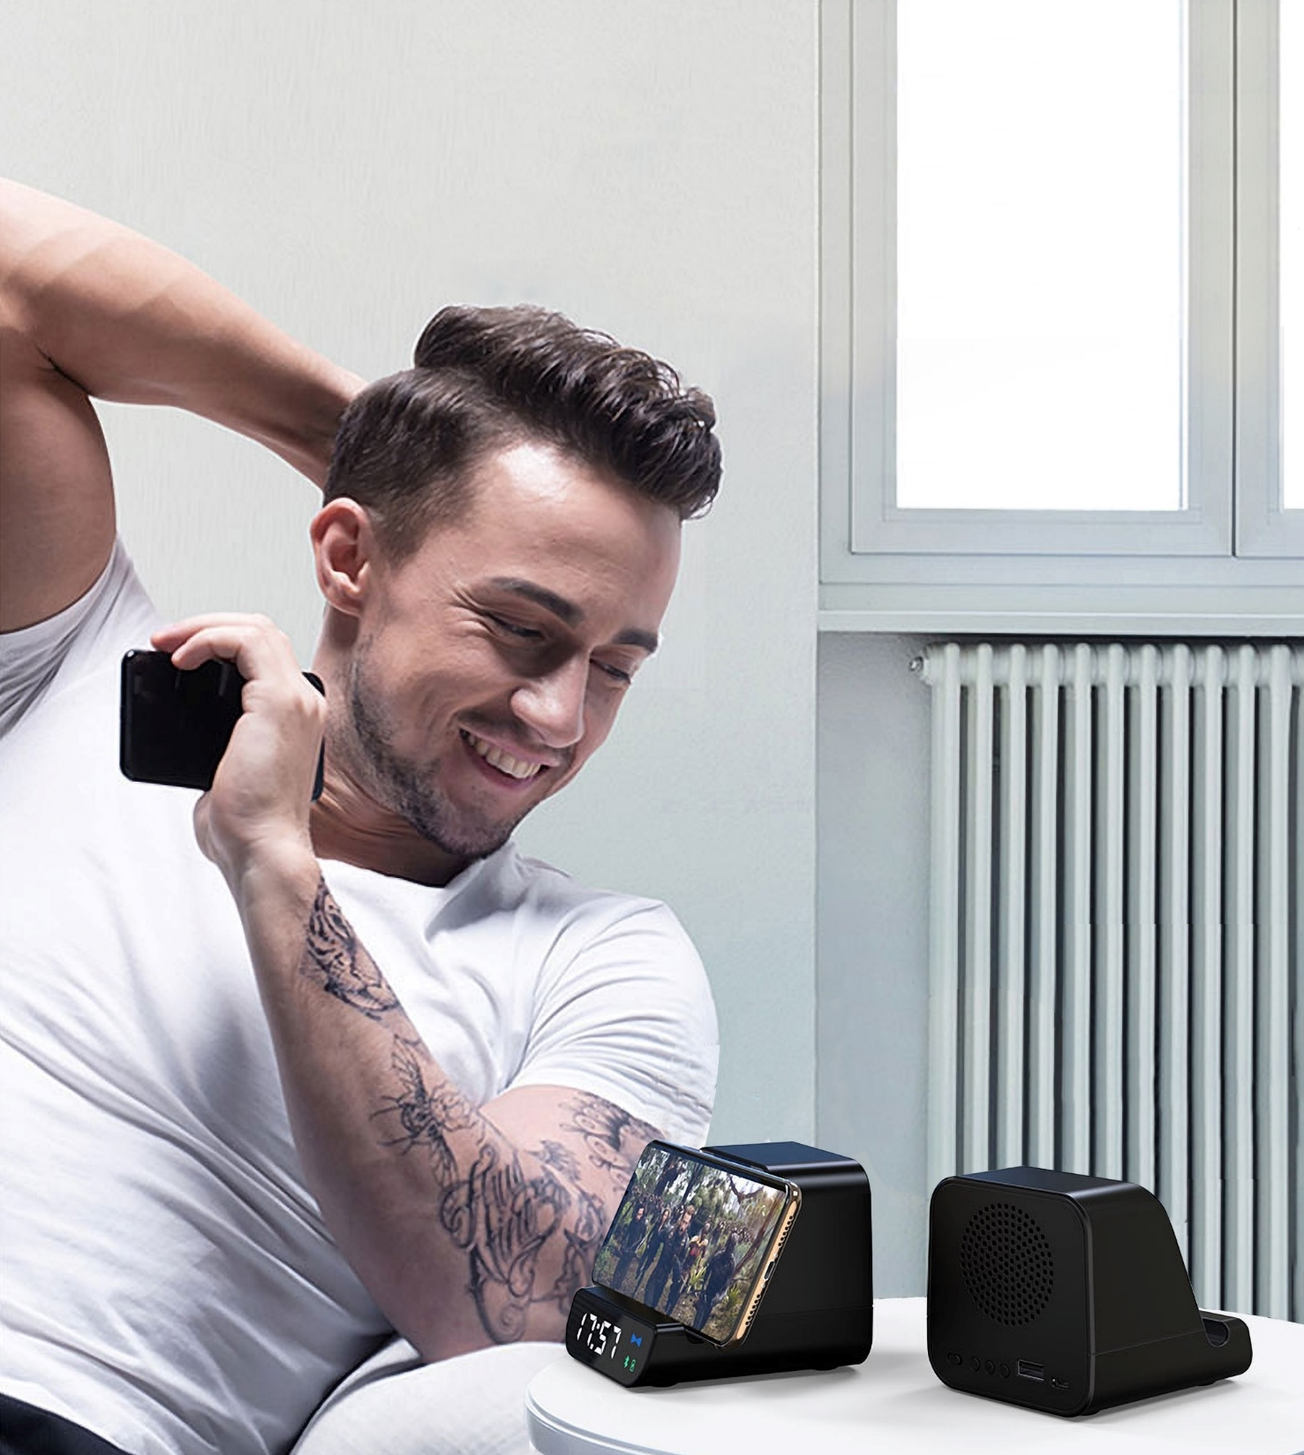
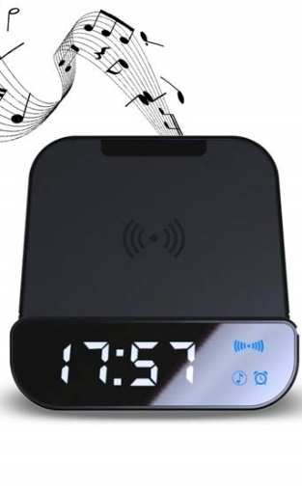
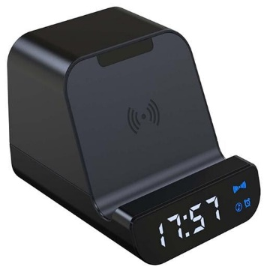
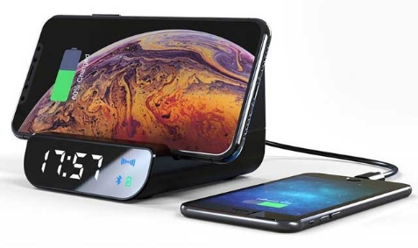
Somoto 5W Wireless 4000mAh Powerbank, Speaker & Alarm Clock
Powerful Sound Wireless Speaker with 10 hours playtime
5W Wireless Charger
Digital Alarm Clock
4000 mAh Built-in powerbank
Quantity | Unit Price
100 | R
250 | R
500 | R
Notes:
ITSP 204

Slide 8
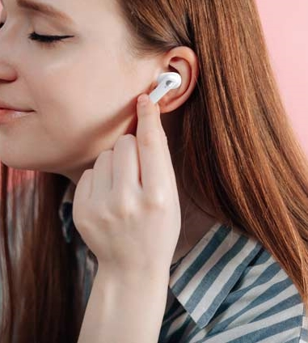
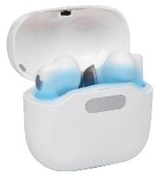
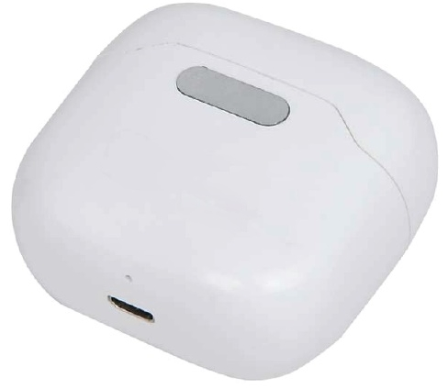
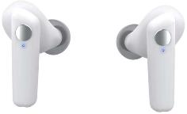
Skole TWS UV-C Earbuds With Sterilization Case
Equipped with UV sterilization, this TWS is cleaner and safer to use
Earbuds in the charging case and the UV will automatically sterilize the bacteria for 90 seconds
The earbuds have a 35 mAh battery and can be re-charged in the 400 mAh charging case
Quantity | Unit Price
100 | R
250 | R
500 | R
Notes:
ITBH 101

Slide 9
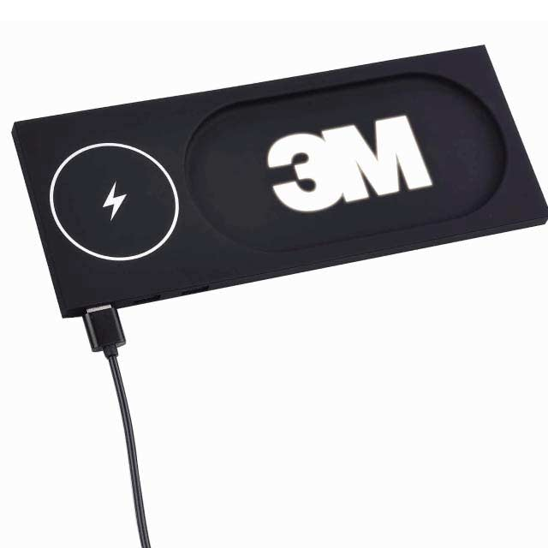
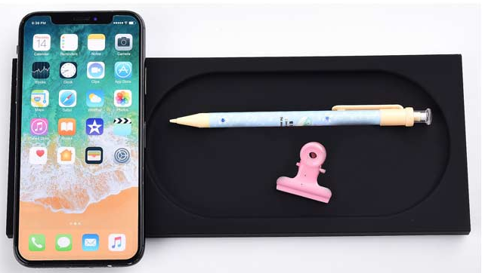
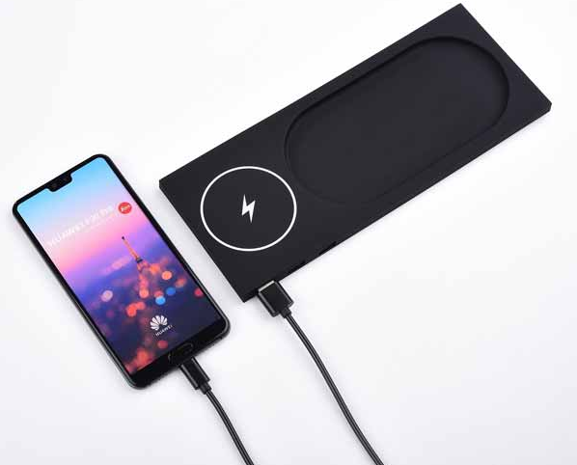
Cergy 5W Wireless Charger Desktop
Cergy is the perfect item for on your desk or table!
The light up logo area on the front allows for a large logo space with great visibility making it a perfect gift
This trendy desk organizer allows you to keep your desk tidy and charge your phone without any wires
Including 100 cm micro USB cable to connect the charger to a power source
5W wireless charging. Input DC 5V/ 1.5A. Output: 5V/800mA
Quantity | Unit Price
100 | R
250 | R
500 | R
Notes:
ITWC 205

Slide 10
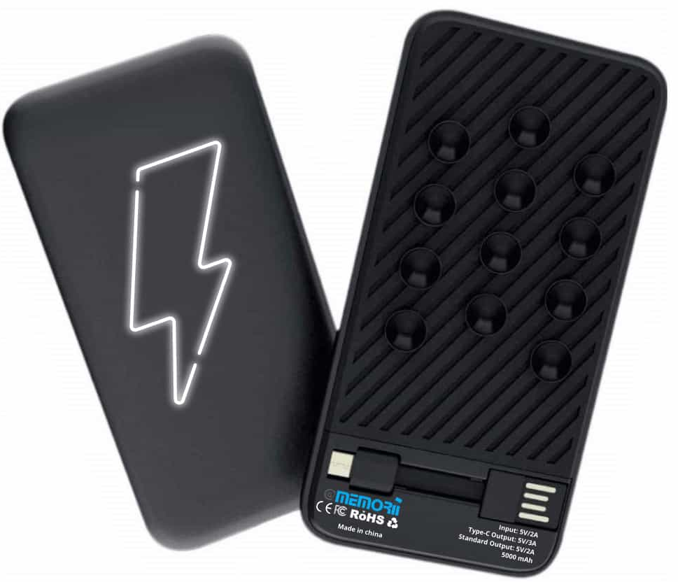
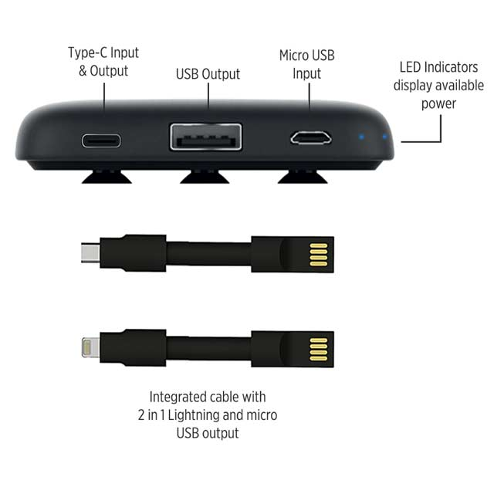
Sopot 5000 mAh Powerbank with Light-Up Logo
Sopot is a 5000 mAh powerbank with USB 2.0 input and Type-C output
The powerbank has the option for an engraved logo on the front panel
A set of 4 LED indicators display available power
Quantity | Unit Price
100 | R
250 | R
500 | R
Notes:
ITPB 463

Slide 11
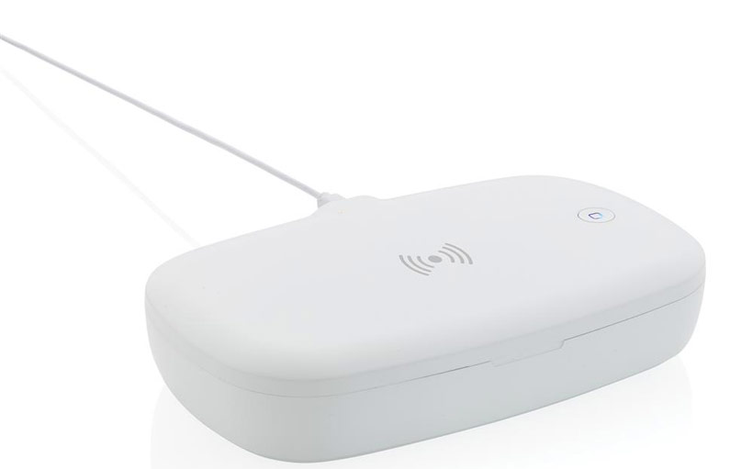
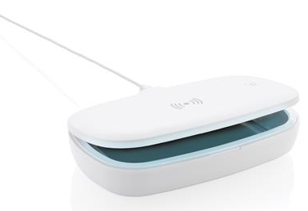
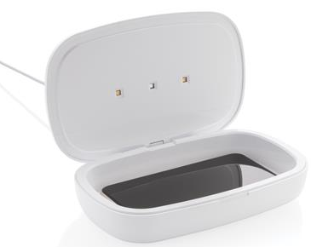
Tigre UV-C Sterilization Box with 5W Wireless Charger
Kills upto 99.9% Bacteria
90 Seconds Quick Clean or 5 Minutes Complete Clean
Built-in 5W Wireless Charger
Quantity | Unit Price
100 | R
250 | R
500 | R
Notes:
ITSN 101

Slide 12
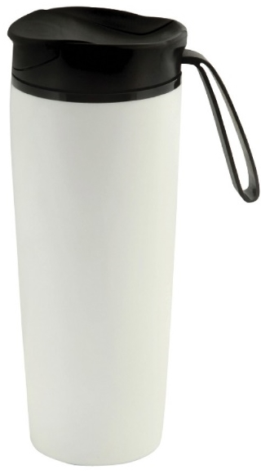
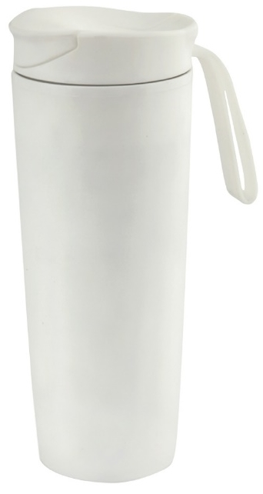
Eunoia Anti-Spill Suction Mug – Stainless Steel Insulated – 470ml
Quantity | Unit Price
100 | R
250 | R
500 | R
470 ml Anti-Spill Mug
Double Walled
Leak Proof Design
Anti-Fall Suction Base
Notes:
DWHL 205, DWHL 208

Slide 13
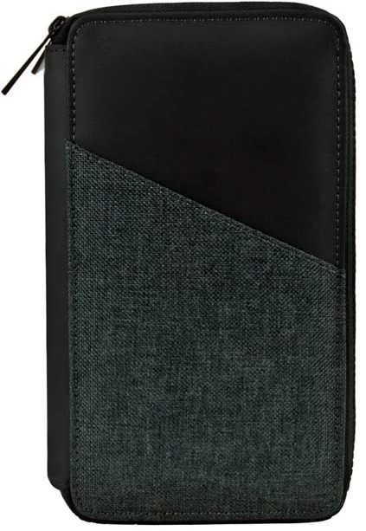
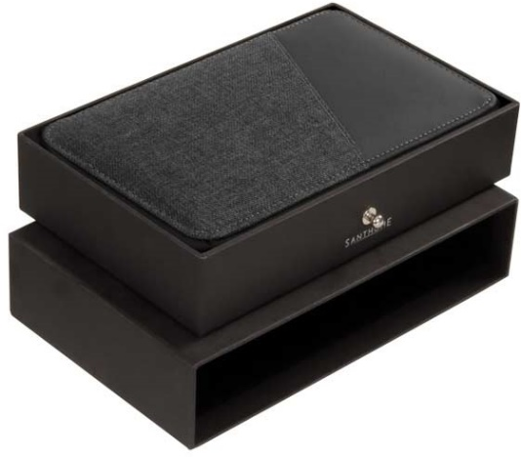
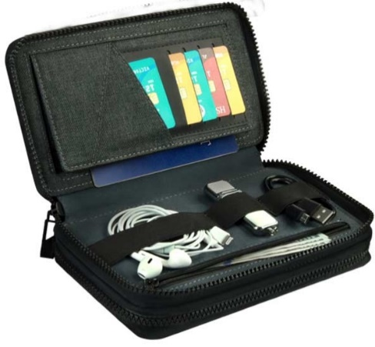
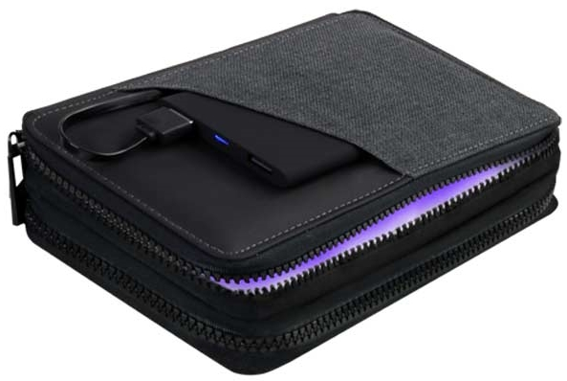
Habry UV-C Sterilization Pouch
Sterilise on the go
UV-C Kills 99.9% bacteria
2 different zippered compartments, for UV-C & for holding travel & daily accessories
Non Toxic Without Mercury
Use your own powerbank / power source or check with us for our range of powerbanks ( Pages 94 to 100 )
Quantity | Unit Price
100 | R
250 | R
500 | R
Notes:
ITSN 104

Slide 14
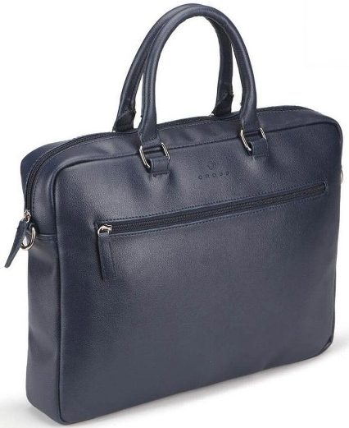
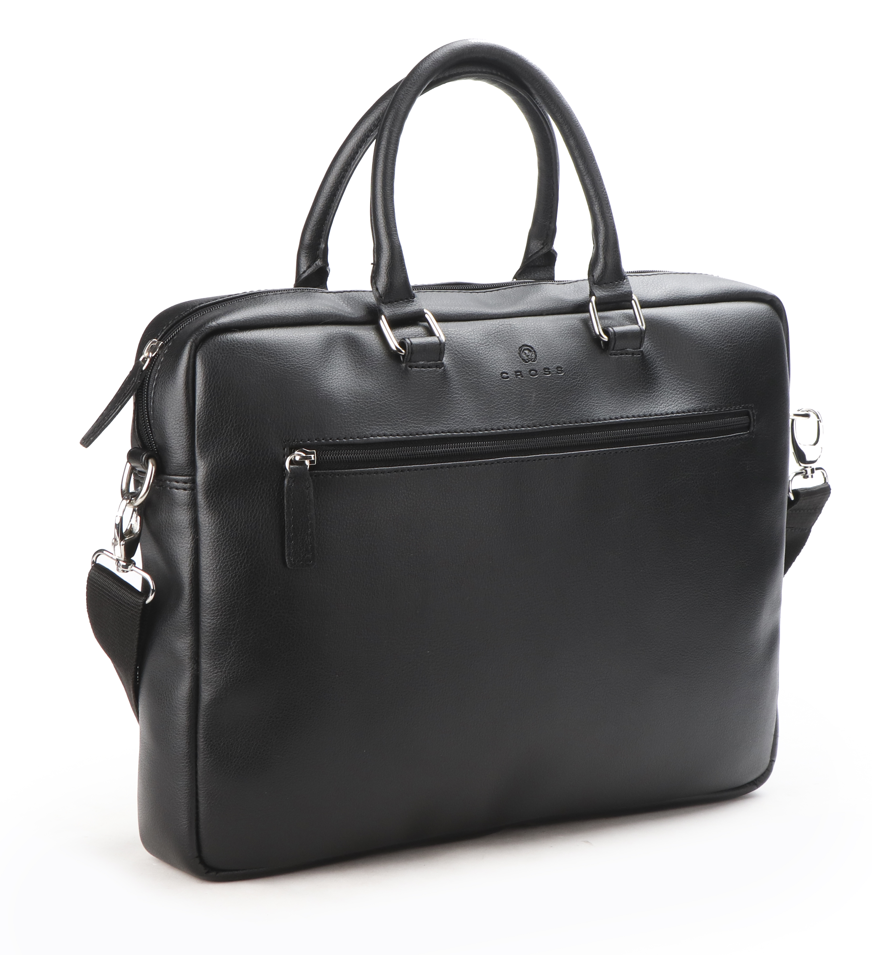
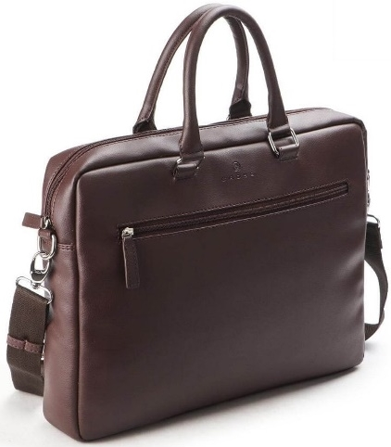
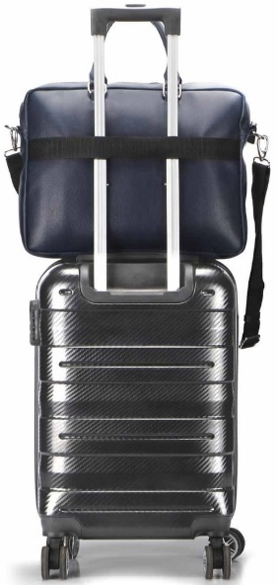
Jasper Office Laptop Briefcase
Office Laptop Bag from Premium Vegan Leather
Trolley strap attaches to trolley bag for ease of travel
Shoulder strap-on the go
Quantity | Unit Price
100 | R
250 | R
500 | R
Notes:
MBCRS 882, MBCRS 883, MBCRS 884

Slide 15
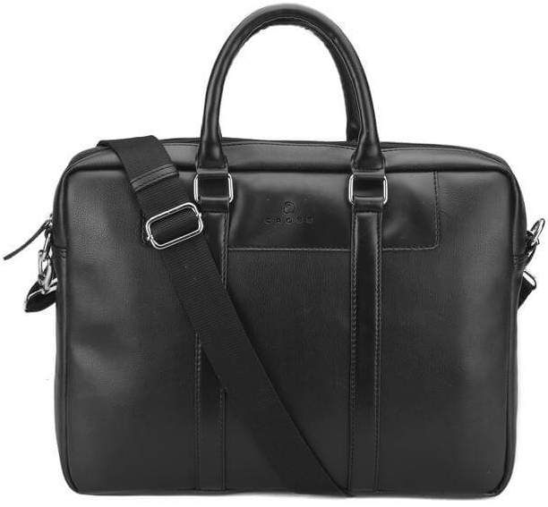
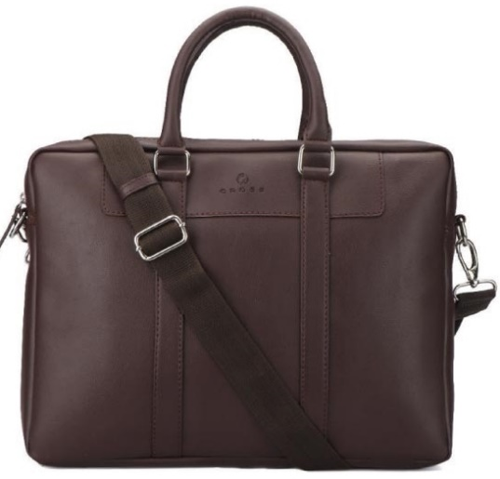
Francisco Office Laptop Briefcase
Office Laptop Bag from Premium Vegan Leather
Elegant Design
Shoulder strap-on the go
Quantity | Unit Price
100 | R
250 | R
500 | R
Notes:
MBCRS 881, MBCRS 887

Slide 16
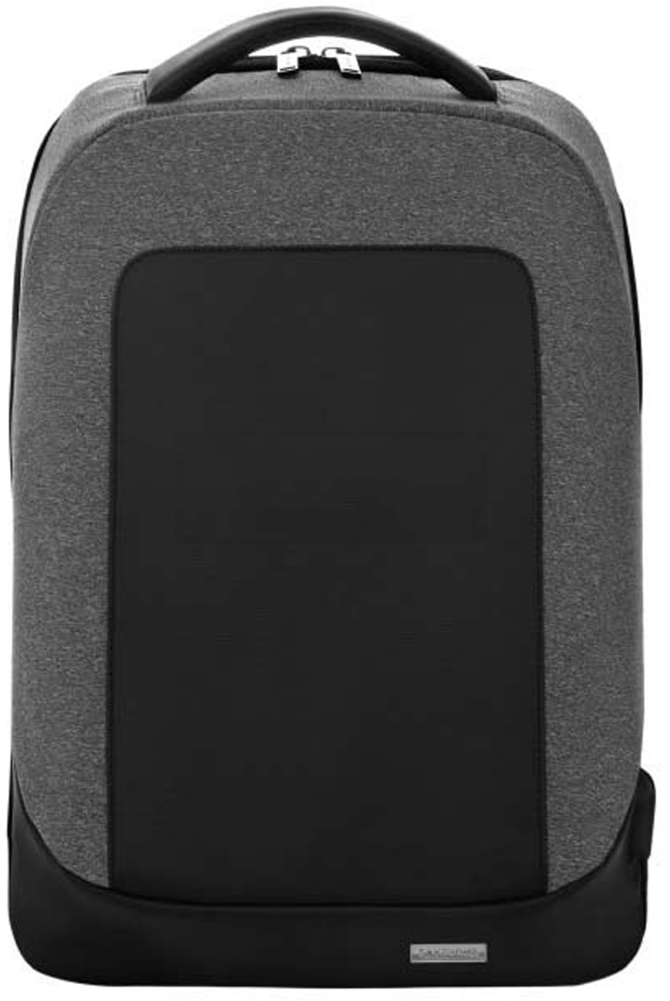
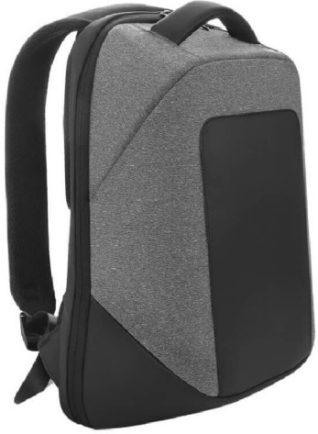
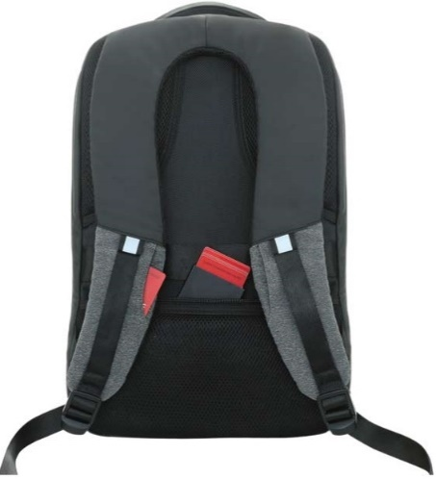
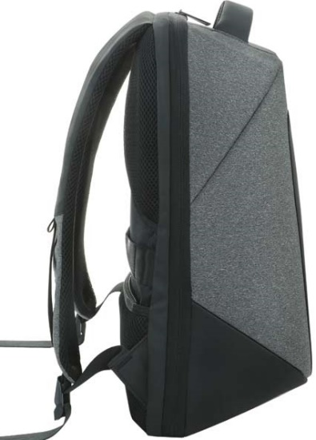
Posadas 17” Laptop Backpack With USB Port
17” Laptop Backpack
Tablet Compartment
Structured Design For Easy Use
Integrated External USB Port
Quantity | Unit Price
100 | R
250 | R
500 | R
Notes:
BPSN 792

Slide 17
Trofa Metal Roller and Ball
Pen Set
Metal Pen Sets
Quantity | Unit Price
100 | R
250 | R
500 | R
Notes:
WIGS 203

Slide 18
Leova Pen (Anti-bacterial)
Treated with Japanese Antibacterial agent produced with SIAA Member
Great BRing Space on clip
Quantity | Unit Price
100 | R
250 | R
500 | R
Notes:
WIPP 820, WIPP 819, WIPP 818

Slide 19
Depok Pen (Anti-bacterial)
Treated for bacterial Effectiveness
1200m writing length
German Dokumental® Ink
Quantity | Unit Price
100 | R
250 | R
500 | R
Notes:
WIPP 822, WIPP 821, WIPP 823

Slide 20
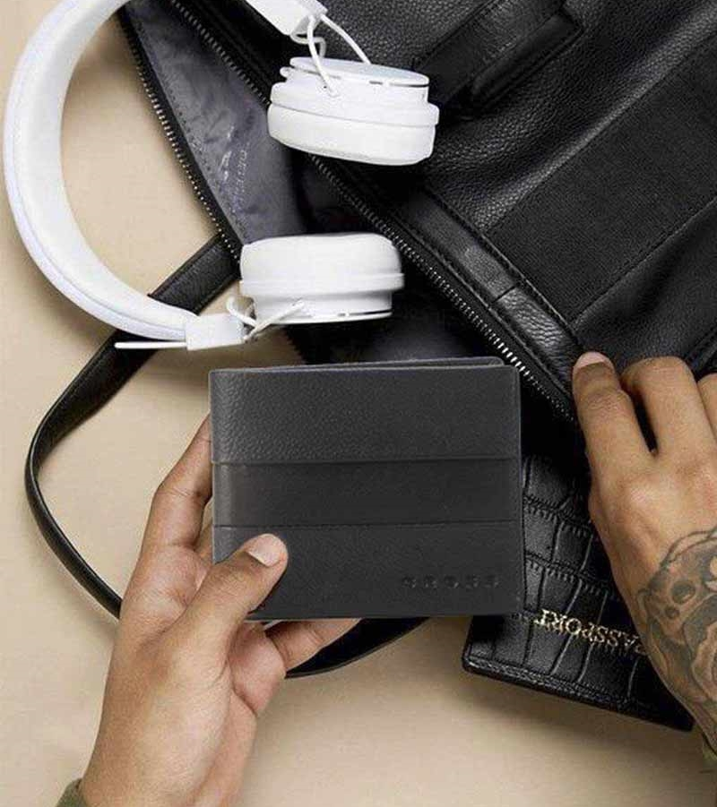
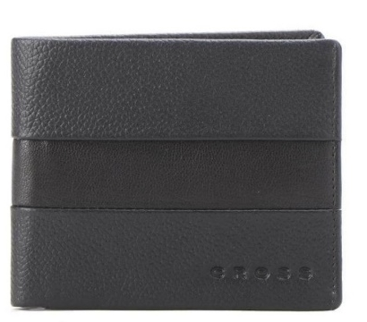
Chester Bi-Fold Leather Wallet with Coin Pocket
CROSS® Genuine Leather Bi-Fold Wallet with Coin Pocket
Made with 100% Genuine Leather
Packed in a Gift Box with an authenticity card inside.
Quantity | Unit Price
100 | R
250 | R
500 | R
Notes:
LACRS 885

Slide 21
Ely Slim Leather Wallet
CROSS® Genuine Leather Bi-Fold Wallet with Coin Pocket
Made with 100% Genuine Leather
Packed in a Gift Box with an authenticity card inside.
Quantity | Unit Price
100 | R
250 | R
500 | R
Notes:
LACRS 886

Slide 22
Cancun Men's Wallet In Genuine Leather
Genuine Leather Men's wallet with contrast grey stitching
The inside of the wallet features 3 card slots, 2 section for banknotes and 1 coin pocket
A special tracker is built into the product to prove that the surface is treated with Biomaster
Packed in a Santhome gift box.
Quantity | Unit Price
100 | R
250 | R
500 | R
Notes:
LASN 652 BIO

Slide 23
Linkuva Genuine Leather Wallet
Genuine Leather Men's Mini Over-flap bifold wallet with space to keep all your pocket essentials
Features 9 Credit Card Pockets, 1 ID Pocket, 2 Slip in Pockets and a large bill compartment
Also features an ID pocket on the outside for easy access
Packed in a gift box
Quantity | Unit Price
100 | R
250 | R
500 | R
Notes:
LAGL 004

Slide 24
Farso - Waste-to-Wins® Recycled Award – Black Swirl
top
packaging
*images not final
side
Crafted from repurposed materials, offering an eco-friendly alternative to traditional awards while reducing waste
Personalized message on any part of the trophy
Made from a unique combination of RCS-certified recycled water bottle caps and FSC-certified upcycled beech wood
Quantity | Unit Price
100 | R
250 | R
500 | R
Packed in an elegant FSC-certified paper box with a thank-you card inside.
Notes:
AWEN 9158, AWEN 9157

Slide 25
Lollar - 15.6" Laptop Backpack
Made of polyester and EVA shell
Comes with small pocket on shoulder strap
Has a USB slot + digital compartment
Comes with in-built password combination lock
Quantity | Unit Price
100 | R
250 | R
500 | R
Notes:
BPGL 2108

Slide 26
Sanok 15.6" RPET Laptop Backpack
Made from RPET fabric, certiﬁed by Global Recycled Standard (GRS)
Elegant slim design, perfect for commuters
3% of sales proceeds of each product is committed to Water.org
This bag has saved 16 L of water
This bag is made from reusing 6 plastic bottles
Quantity | Unit Price
100 | R
250 | R
500 | R
Notes:
BPSN 2103, BPSN 2136, BPSN 2135

Slide 27
Ablar - GRS-certified Recycled Cotton Tote Bag – 140GSM
Certified by Global Recycled Standard (GRS)
Made with 140GSM recycled cotton - a light and durable fabric.
Saved 1,200 L of water by substituting water-thirsty cotton fabric with recycled cotton.
Quantity | Unit Price
100 | R
250 | R
500 | R
Product Dimensions:- 42 x 36 x cm
Notes:
CTEN 423, CTEN 422, CTEN 421 CTEN 420

Slide 28
Kovel Double Walled Insulated Flask with Temperature Lid
Inside Temperature Display on lid
Popular Design
Food Grade
8 hours hot, 12 hours cold
Quantity | Unit Price
100 | R
250 | R
500 | R
Notes:
DWGL 3116, DWGL 3117, DWGL 3119, DWGL 3118

Slide 29
Moss - Steel/PP Double Wall Tumbler - 350ml
Steel inner / PP outer Double Walled Tumbler
Spillproof Lid
350ml capacity
Quantity | Unit Price
100 | R
250 | R
500 | R
Notes:
DWGL 3188, DWGL 3189, DWGL 3190

Slide 30
Grodno Soft Touch Insulated
Water Bottle – 500ml
Vacuum Insulated S.S. bottle
Cold for 10 hours, Hot for 5 hours 500 ml Capacity
Double Walled Leakproof
SS 304 inside SS 201 outside
Elegant Soft Touch
Quantity | Unit Price
100 | R
250 | R
500 | R
Notes:
DWGL 365, DWGL 367, DWGL 368, DWGL 366

Slide 31
Eunoia Anti-Spill Suction Mug – Stainless Steel Insulated – 470ml
470 ml Anti-Spill Mug
Double Walled
Leak Proof Design
Anti-Fall Suction Base
Quantity | Unit Price
100 | R
250 | R
500 | R
Notes:
DWHL 208, DWHL 206, DWHL 207

Slide 32
Aversa - RCS Recycled Stainless Steel Insulated Water Bottle
Premium RCS-certified Recycled SS Water Bottle
Double walled Vacuum Insulated
Uses SS304 inside and outside
Contains 83% recycled stainless steel
650ml capacity
Quantity | Unit Price
100 | R
250 | R
500 | R
Notes:
DWHL 3160, DWHL 3161

Slide 33
R-Laren Recycled Insulated Mug
3% of sales proceeds of each product committed to Water.org
15 hours cold, 5 hours hot
A Designer Mug that supports Sustainable living
Double-Walled
SS 304 Inside, SS 201 Outside
Quantity | Unit Price
100 | R
250 | R
500 | R
Notes:
DWHL 3177, DWHL 3179, DWHL 3222, DWHL 3219, DWHL 3223, DWHL 3179

Slide 34
Ruvo - Change Zero 2-in-1 Modular Hydration Gift Set
RUVO by Hans Larsen is a 2-in-1 modular hydration set with interchangeable water bottle and leakproof coffee tumbler lids, double walled vacuum insulated stainless steel (SS304 inside and outside) and robust construction quality
Switch comfortably between both lid types for a bottle or tumbler drinking experience
This set is perfect for drinks of all temperatures, and the wide mouth makes it easy to add ice cubes
Packed in a sustainable, recyclable kraft box
A carbon neutral product
Quantity | Unit Price
100 | R
250 | R
500 | R
Notes:
DWHL 3206, DWHL 3207, DWHL 3208

Slide 35
Laren Insulated Mug
3% of sales proceeds of each product committed to Water.org
15 hours cold, 5 hours hot
A Designer Mug that supports Sustainable living
Double-Walled Vacuum Insulated
Recycled Gift Box Packaging
Quantity | Unit Price
100 | R
250 | R
500 | R
Notes:
DWHL 333, DWHL 334, DWHL 335, DWHL 336, DWHL 341, DWHL 342

Slide 36
Breda Insulated Water Bottle
Double-Walled Vacuum Insulated water bottle
560 ml Capacity
Vibrant Colours
High quality
3% of sales proceeds of each product committed to Water.org
24 hours cold, 8 hours hot
Quantity | Unit Price
100 | R
250 | R
500 | R
Notes:
DWHL 337, DWHL 338, DWHL 339, DWHL 340, DWHL 343, DWHL 344

Slide 37
Campina Hard Cover Notebook with Metal Pen
Pen Attaches To The Magnet On The Notebook
160 Pages ; 80 gsm
Gift Box
Value Deal
Quantity | Unit Price
100 | R
250 | R
500 | R
Notes:
GSGL 301, GSGL 302, GSGL 303

Slide 38
Lauta Set of Stainless Bottle, Notebook and Pen
Gift Set with colour matched items
Vacuum Bottle, Metal Pen and A5 notebook in gift box
All items with premium soft touch coating
Quantity | Unit Price
100 | R
250 | R
500 | R
Notes:
GSGL 861, GSGL 864, GSGL 863, GSGL 862

Slide 39
Koksi - Set of Double Walled Tumbler, A5 Notebook and Pen
Value Gift Set with 3 color matched items
Tumbler is 350ml, leakproof and double walled
Notebook is A5, soft touch with 192 pages
Plastic Pen with hexagonal barrel design
Quantity | Unit Price
100 | R
250 | R
500 | R
Notes:
GSGL 9548, GSGL 9549, GSGL 9550

Slide 40
Almelo Insulated Drinkware Set
High quality, elegant set
Flask Capacity 600ml
Tumbler Capacity 180ml
Quantity | Unit Price
100 | R
250 | R
500 | R
Notes:
GSHL 102

Slide 41
Vardim - Sustainable Gift Set with Refillable Notebook & Pen
Vardim is a CHANGE ZERO Sustainable Gift Set containing a GRS-certified recycled PU refillable A5 ruled hardcover notebook and a matching recycled PU ball pen.
It is developed with a net zero carbon footprint - by using GRS-certified recycled PU materials, we reduce 36% carbon emissions by recycled material use (calculated by ecoact®). Further, we offset the balance 1.25 kgCO2eq per unit by financing renewal energy projects through Climate Partner, making it a carbon-zero product. Packed in an elegant gift box.
Quantity | Unit Price
100 | R
250 | R
500 | R
Notes:
GSSN 9539, GSSN 9541

Slide 42
Lenzen - Sustainable Gift Set with Refillable Notebook, Pen & USB Keychain
keychain
Lenzen is a CHANGE ZERO Sustainable Gift Set containing a GRS-certified recycled PU refillable A5 ruled hardcover notebook, matching recycled PU ball pen and recycled PU keychain with 32GB USB flash drive
Developed with a net zero carbon footprint - By using GRS-certified recycled PU materials, we reduce 37% carbon emissions by recycled material use (calculated by ecoact®). Further, we offset the balance 1.23 kgCO2eq per unit by financing renewal energy projects through Climate Partner, making it a carbon-zero product. Packed in an elegant gift box.
pen
notebook
Quantity | Unit Price
100 | R
250 | R
500 | R
Notes:
GSSN 9542, GSSN 9544

Slide 43
Tessin - Sustainable Gift Set with Refillable Notebook, Pen & Cardholder
pen
Tessin CHANGE ZERO is a sustainable gift set containing a GRS-certified recycled PU refillable A5 ruled hardcover notebook, matching recycled PU ball pen and recycled PU sliding cardholder
Developed with a net zero carbon footprint - By using GRS-certified recycled PU materials, we reduce 29% carbon emissions by recycled material use (calculated by ecoact®). Further, we offset the balance 1.76 kgCO2eq per unit by financing renewal energy projects through Climate Partner, making it a carbon-zero product. Packed in an elegant gift box.
notebook
Quantity | Unit Price
100 | R
250 | R
500 | R
cardholder
Notes:
GSSN 9545, GSSN 9547

Slide 44
Eternity - The Reusable Notebook & Pen Set
WATCH THE
PRODUCT VIDEO
Explore eternal writing with the Santhome Eternity Notebook & Pen Set
Perfect for students and professionals who want to be more organized by combining handwritten notes with digital technology
Santhome Eternity includes a spiral notebook made from special erasable paper and a Santhome erasable pen for a smooth writing experience
Once all pages are used, use the Evernotes app to scan/organize important notes
Make a sustainable choice with reusable tree-free notebooks, and never throw another notebook away
Packed in an eco-friendly kraft paper gift box
Quantity | Unit Price
100 | R
250 | R
500 | R
Notes:
GSSN 9553, GSSN 9554

Slide 45
Onex - Recycled 10000mAh 15W MagSafe Wireless A5 Organizer 32GB
WATCH THE
PRODUCT VIDEO
Smart Mag A5 10,000mAh Powerbank Organizer
15W Mag Charging with Flat/Standing modes
Light Up Logo engraving
32GB USB flash drive
Made from GRS-certified recycled PU
CHANGE ZERO - A carbon-neutral product
Quantity | Unit Price
100 | R
250 | R
500 | R
Notes:
ITFO 1199, ITFO 1200, ITFO 1201

Slide 46
Abaza - Mag Card Holder
Magnetically attaches to iPhone 12 / 13 / 14 / 15
Comes with a magnetic ring to make it compatible to other phone models
Holds up to 2 cards
Elegant PU Leather
Quantity | Unit Price
100 | R
250 | R
500 | R
Notes:
ITGL 1150

Slide 47
Arles – Recycled Wireless Powerbank - 10,000mAh
10,000mAh 5W Wireless powerbank
Made from Certified Recycled Plastic & FSC Bamboo
3% of sales proceeds of each product committed to Water.org
Quantity | Unit Price
100 | R
250 | R
500 | R
Notes:
ITPB 1112

Slide 48
Kepno – Super Fast Charging PD 10000mAh Powerbank
Charge up to 50% under 30 minutes
About 2-2.5x fast charging compared to standard powerbanks
PD is the latest standard in USB-C super fast charging
Super Fast Charging 18W 10,000mAh PD powerbank
Quantity | Unit Price
100 | R
250 | R
500 | R
Notes:
ITPB 1122

Slide 49
Albeck - Recycled Leather 10000mAh PD Powerbank
Uses RCS-certified recycled leather for an executive look and feel
10000mAh battery capacity with 10W wireless charging
Contains 18W PD output for a super quick charge!
18W PD can charge a full battery in 1 hour
Quantity | Unit Price
100 | R
250 | R
500 | R
Notes:
ITPB 1140, ITPB 1141

Slide 50
Capsule - 4500mAh Mini Powerbank with Inbuilt Cable and Phone Stand
Mini capsule-sized powerbank
With 4500mAh battery for emergency power on-the-go
Inbuilt Type-C and Lightning output pins
With phone stand
Quantity | Unit Price
100 | R
250 | R
500 | R
Notes:
ITPB 1227

Slide 51
Adorf Recycled Bluetooth (BT 5.3) Headphone
Made from RCS-Certified Recycled Plastic
Recycled wireless headphones with BT5.3
3% of sales proceeds of each product committed to Water.org
6 hours Playtime, and 10m Wireless range
Quantity | Unit Price
100 | R
250 | R
500 | R
Notes:
ITPH 1109

Slide 52
Santhome Card - Digital Business NFC Card
The fastest, most innovative to share your business information!
owered by Santhome, this NFC card is a modern alternative to traditional paper business cards.
Instantly share all your essential business contact information, social links, photos, company information, meetings calendar and more with 1 tap or scan the QR code.
It is very cost-effective, environment-friendly, and works completely app-free - no download required so start using Santhome Card immediately!
The entire front side is fully customizable and has infinite uses! It is a great tool for lead generation and digital asset integration.
Credit card size to fit any wallet.
Compatible with iPhone and Android without app installation! GDPR compliant.
Quantity | Unit Price
100 | R
250 | R
500 | R
Notes:
ITSN 1180, ITSN 1181

Slide 53
TAG - Smart Worldwide Item Tracker (Apple MFI-certified)
WATCH THE
PRODUCT VIDEO
Worldwide Tracking using iOS Find My app
Santhome Tag is approved and registered by Apple's MFI-license program
1-2 years battery life
Replaceable CR2032 3V pencil battery
Quantity | Unit Price
100 | R
250 | R
500 | R
Notes:
ITSN 1210

Slide 54
Asperg - Recycled Wireless Bluetooth Speaker
Made from Certified Recycled Plastic & FSC Bamboo
Recycled wireless speaker with BT5.1
6 hours playtime, and 10m wireless range
3% of sales proceeds of each product committed to Water.org
Quantity | Unit Price
100 | R
250 | R
500 | R
Notes:
ITSP 1110

Slide 55
Sevan - Retro Wood 10W Bluetooth Speaker with FM
Powerful 20W stereo sound (2 loud speakers inside+ bass)
Multiple pairing options via bluetooth, AUX in, TF card and USB host
With FM Radio receiver function
Classic retro design
Quantity | Unit Price
100 | R
250 | R
500 | R
Notes:
ITSP 1143

Slide 56
Spassk - Phonograph Bluetooth Speaker
Mini-Turntable styled 3W Bluetooth Speaker
Lift the tonearm to start/stop music
Features a 10m pairing distance
and 3 hours of playback time
A really unique gift that mimics
a retro vinyl player / turntable.
Quantity | Unit Price
100 | R
250 | R
500 | R
Notes:
ITSP 1179

Slide 57
Tasova - Recycled 15W Wireless Charger Bluetooth Speaker
Multi-functional 4-in-1 BT 5.1 wireless speaker, 15W wireless charger, lamp and phone stand
Made of 58.96% RCS-certified recycled plastic and recycled leather
Warm and RGB LED lighting
A must-have for the office desk or at home
Quantity | Unit Price
100 | R
250 | R
500 | R
Notes:
ITSP 1182, ITSP 1183

Slide 58
Rovik - 3-in-1 Bluetooth Speaker with Sleep Machine and 15W Wireless Charger - Black
3W Bluetooth Speaker-3-6HR playtime
Plug into power for 15W wireless charging
Improve sleep using the 6 saved soothing sounds
Quantity | Unit Price
100 | R
250 | R
500 | R
Notes:
ITSP 1214

Slide 59
Elstra – Recycled 15W Wireless Charger
15W Wireless Charger (Fast Charging)
3% of sales proceeds of each product committed to Water.org
Compatible with all wireless charging phones
Made from Certified Recycled Plastic & FSC Bamboo
Quantity | Unit Price
100 | R
250 | R
500 | R
Notes:
ITWC 1113

Slide 60
Anzio - Recycled Leather 15W Wireless Charger
Uses RCS-certified recycled leather for an executive look and feel
15W Wireless Charging
With 4 anti-slip pads
Quantity | Unit Price
100 | R
250 | R
500 | R
Notes:
ITWC 1138, ITWC 1139

Slide 61
Veles - 3 in 1 Wireless Charger with Desk Lamp
Dual Smart Light with 3-in-1 Wireless Chargers
Simultaneous charging for smartphone, earpods and smart watch
For smart watches, insert your charger into the provided slot
Multiple LED light settings
Aluminum stand for strength & elegance
Quantity | Unit Price
100 | R
250 | R
500 | R
Notes:
ITWC 1145, ITWC 1146

Slide 62
Mio - 15W Car Mobile Mount Wireless Charger w/ Light Up Logo
4-in-1 Must-have in every car for safe car driving
Smart sensor for mobile phone gripping
15W wireless charger and phone holder
Comes with safety features like seat belt cutter and window breaker
Quantity | Unit Price
100 | R
250 | R
500 | R
Notes:
ITWC 1153

Slide 63
Bolero - 2 in 1 Wireless Charger with Multi Cable Set
Exclusive Multipurpose Travel and Desk Accessory
Foldable Dual Wireless Charger for smart phones and smartwatch / earpods
Multi-Cable Set includes all your essential charging connections
Quantity | Unit Price
100 | R
250 | R
500 | R
Notes:
ITWC 1154, ITWC 1175

Slide 64
Basel - Recycled 10W Wireless Charger Phone Stand
10W Dual Wireless Charger & Phone Stand
Made from 69% RCS-certified recycled ABS + recycled PU leather
Dual coil charging allows vertical or horizontal charging option
Quantity | Unit Price
100 | R
250 | R
500 | R
Notes:
ITWC 1159, ITWC 1160

Slide 65
Oslo - Recycled 15W Wireless Charger Multi - Cable Set
Sleek travel multi-cable + accessories set
With 15W Wireless Charger on the back
Made from RCS-certified recycled plastic
Elegant magnetic closing Includes ejector pin + 3 SIM slots
Quantity | Unit Price
100 | R
250 | R
500 | R
Notes:
ITWC 1169, ITWC 1170, ITWC 1171

Slide 66
Camden - 14" Felt Laptop Sleeve With 15W Magnetic Charger
Fits up to 14" laptop
Can also serve as desk mat or mousepad
Inbuilt 15W Mag Wireless Charging
Felt / PU combo and minimalist design
Quantity | Unit Price
100 | R
250 | R
500 | R
Notes:
ITWC 1195, ITWC 1196

Slide 67
Blace - Recycled PU 15W Wireless Mousepad & Desk Organizer
Multi-functional mousepad & desk organizer
15W fast wireless charging
Phone and Pen Stands
Made from GRS-certified recycled PU
CHANGE ZERO - A carbon-neutral product
Quantity | Unit Price
100 | R
250 | R
500 | R
Notes:
ITWC 1202, ITWC 1203, ITWC 1204

Slide 68
Tovuz - 10,000 mAh Magnetic Wireless Powerbank in Gift Box
Latest magnetic wireless powerbank for iPhone 12+
Includes magnetic ring for compatibility with other phones
10,000mAh battery capacity
Packed in a luxury magnet closing gift box
Quantity | Unit Price
100 | R
250 | R
500 | R
Notes:
ITWC 1217, ITWC 1218

Slide 69
Almere - 3-in-1 Desk Lamp with 15W Wireless Charger & Pen Holder
Almere is a 3-in-1 Desk Lamp
360° Adjustable Flexible Desk Lamp
3 LED options: Warm/Light/Natural
Pen Holder & Stationery Storage
15W Wireless Charging Function
Quantity | Unit Price
100 | R
250 | R
500 | R
Notes:
ITWC 1225, ITWC 1226

Slide 70
Rotterdam - 10,000mAh Universal Wireless Powerbank with inbuilt cables - Black
5-in-1 universal 10,000mAh powerbank
Includes 2 super-fast 15W Magnetic Wireless Chargers
Capable to charge 4 devices simultaneously-iPhones, Android, Smartwatch, etc.
Inbuilt Lightning and Type C cables
Supports PD 20W ultra-fast charge
Quantity | Unit Price
100 | R
250 | R
500 | R
Notes:
ITWC 1228

Slide 71
Salcea - 15" Laptop Sleeve
Sleek 15" laptop sleeve
Padded protection for laptops
Quantity | Unit Price
100 | R
250 | R
500 | R
Notes:
LSSN 2175, LSSN 2176

Slide 72
Fulda RPET 15.6” Laptop Case & Workstation
Made from GRS-certified RPET and stylish faux feather. Each recycled bag saves 2.5L of water, reuses 3 plastic bottles, and contributes to water.org
Trendy 2-in-1 design for laptop sleeve and workstation
Lifts laptops 6cms for better work comfort
Versatile pockets in the back
Portable and easy to carry
Uses high quality magnets for the cover and laptop stand
Quantity | Unit Price
100 | R
250 | R
500 | R
Notes:
LSSN 411 Black, LSSN 412 Grey

Slide 73
Sloten - 15" Laptop Bag
Sleek 15" laptop bag
Padded protection for laptops
Quantity | Unit Price
100 | R
250 | R
500 | R
Notes:
MBSN 2173, MBSN 2174

Slide 74
Brela - Set of Recycled Laptop Stand and retractable cable
A set of laptop stand and retractable charging cable
RCS-certified
Laptop stand is made of 94% Recycled ABS and Recycled PU
Charging cable is made of 29% Recycled ABS and Recycled PU
Laptop stand allows different angles for better comfort & use
Quantity | Unit Price
100 | R
250 | R
500 | R
Notes:
MTGS 1167, MTGS 1168

Slide 75
Sulza Recycled 6-in-1 Multi Cable
6-in-1 Cable made from Certified Recycled TPE & FSC Bamboo
3% of sales proceeds of each product committed to Water.org
Quantity | Unit Price
100 | R
250 | R
500 | R
Notes:
MTST 1111

Slide 76
Tavira Recycled Multi-Cable Set
Sleek Travel-Friendly Cable Case with all 6 cable combinations + ejector pin + 3 SIM card slots for various sizes
Made from Recycled Claim Standard (RCS) Plastic, certified by Intertek
Elegant magnetic Closing
Convenient Mobile Holder attachment
Quantity | Unit Price
100 | R
250 | R
500 | R
Notes:
MTST 1126, MTST 1127, MTST 1128

Slide 77
Lecco - Recycled 6-in-1 retractable Charging Cable
Retractable 6-in-1 charging cable
Made from 29% RCS-certified recycled plastic and recycled PU
Cable extends up to 100CM in length
Quantity | Unit Price
100 | R
250 | R
500 | R
Notes:
MTST 1165, MTST 1166

Slide 78
Borsa Eco-neutral A5 Cork Fabric Hard Cover Notebook and Pen Set
Notebook made from elegant combination of cork and cotton fabric. 160 pages
Pen made from cork and wheat straw material with matching colours
Packed in an eco gift box
Quantity | Unit Price
100 | R
250 | R
500 | R
Notes:
NBEN 103, NBEN 5103, NBEN 5101

Slide 79
Kotel - A5 Recycled Leather Soft Cover Notebook
A5 softcover notebook with elastic closure
GRS-certified recycled bonded leather cover
Contains 160 FSC-certified lined pages from well managed forests
Quantity | Unit Price
100 | R
250 | R
500 | R
Notes:
NBEN 5163

Slide 80
Neya - Stone Paper Tree-Free Notebook
Note-taking made more sustainable!
Paper from from 80% limestone 100% tree-free paper
Enjoy friction-free writing due to smoothness of stone paper
Uses zero water or bleach
100% water-proof
Quantity | Unit Price
100 | R
250 | R
500 | R
Notes:
NBEN 5196, NBEN 5197, NBEN 5200, NBEN 5201

Slide 81
BUREN - Sugarcane Paper A5 Notebook
Beautiful A5 design
Pages and cover both made from sugarcane pulp
Packed in paper sleeve packing
Quantity | Unit Price
100 | R
250 | R
500 | R
Notes:
NBEN 5256, NBEN 5257, NBEN 5258

Slide 82
Kinel - Cactus Leather Journal Notebook
Cover is made from leaves of the cactus plant which contains 45% cactus material by weight
192 FSC-certified black-edged pages
3% of sales proceeds of each product is committed to Water.org
FSC-Certified Gift box packing
Quantity | Unit Price
100 | R
250 | R
500 | R
Notes:
NBSN 5150

Slide 83
Peja - A5 Recycled PU Soft Cover Notebook
A5 Softcover Notebook Cover made from GRS-certified recycled PU Leather
160 FSC-certified pages from well managed forests
Stylish elastic closure
Quantity | Unit Price
100 | R
250 | R
500 | R
Notes:
NBSN 5152, NBSN 5153

Slide 84
Eternity eco-neutral Bamboo 100x Long Lasting Pencil
Bamboo eternity pencil writes up to 20,000 metres
Replaces 100 traditional wooden pencils
No sharpening needed
Quantity | Unit Price
100 | R
250 | R
500 | R
Notes:
WIEN 877

Slide 85
Massa - Recycled Aluminum Ball Pen
Barrel made from RCS-certified Recycled Aluminum
Recycled aluminum uses 95% less energy vs producing from its raw form
3% of sales proceeds of each product is committed to Water.org
Quantity | Unit Price
100 | R
250 | R
500 | R
Notes:
WIMP 5166

Slide 86
Hofn - Rechargeable Mini Hand Fan - White
Rechargeable Battery
Up to 4 hours of use on single charge
With carabiner that doubles as a stand
3 speed options
Quantity | Unit Price
100 | R
250 | R
500 | R
Notes:
WNFN 9141

Slide 87
Urbino - RPET Auto-Open 23" Umbrella with SPF50 UV Protection
Made From GRS-certified 190T Recycled PET fabric
3% sales of proceeds of each umbrella is committed to Water.org
Auto Open/Close function
Fiberglass frame for strength
SPF50 UV protection to lesson exposure from harmful UV rays
Sustainable GRS certified fabric made from 6 plastic bottles
Quantity | Unit Price
100 | R
250 | R
500 | R
Notes:
WSSN 2001

Slide 88
Baruth - Giftology GRS-certified Recycled RPET Backpack
Made from GRS Certified rPET
Modern minimalist design
Quantity | Unit Price
100 | R
250 | R
500 | R
Notes:
BPGL 676, BPGL 675, BPGL 674

Slide 89
Castile- UV-C Sterilization Backpack in Anti-microbial RPET Fabric
Recycled PET Commuter 15.6" Laptop Backpack - Made from highly durable Antimicrobial 1680D RPET, this backpacks stops ocean plastic pollution and features a front pocket with 5 min UV-C disinfection / sterilization pocket (requires own powerbank) to keep your everyday essentials sanitized and free from germs.
This bag protects the environment while keeping you safe as well.
Other features of this backpack include an USB output, RFID pockets, pen loops and a side water bottle pocket.
Quantity | Unit Price
100 | R
250 | R
500 | R
Notes:
BPSN 795

Slide 90
Niesky Copper Vacuum Insulated Double Wall Water Bottle – 500ml
COPPER VACUUM INSULATED
Copper plated inner walls for longer hours of enjoyment
Dual copper and vacuum insulation
12 hours hot, 20 hours cold
Comes in 8 vibrant corporate colors
500 ml capacity
Quantity | Unit Price
100 | R
250 | R
500 | R
Notes:
DWGL 541, DWGL 543, DWGL 546, DWGL 547

Slide 91
Galati Canteen Reusable Water Bottle with Insulation – 450ml
Easy Grip, Flat Sides
SS 304 Inside, SS 201 Outside
Wide Mouth Fits Ice Cube
Screw-On Cap; BPA Free
12 Hours Cold And 8 Hours Hot
Quantity | Unit Price
100 | R
250 | R
500 | R
Notes:
DWHL 401, DWHL 402, DWHL 403

Slide 92
Megara Borosilicate 550 ml
Glass Bottle
Borosilicate Glass Body & Eco Bamboo Top Cap
Silicon Sleeve For Protection
Eco-Friendly
Quantity | Unit Price
100 | R
250 | R
500 | R
Notes:
DWHL 502

Slide 93
Hengelo - Tumbler with Light-Up Logo
Double wall tumbler.
304 SS inside and ABS plastic outside.
Engrave your logo and when you pick up the bottle, logo on tumbler will light up for optimal brand exposure.
Including 2 CR2032 cell battery.
Content: 180 ml. Fits most coffee machines.
Quantity | Unit Price
100 | R
250 | R
500 | R
Notes:
DWHL 509

Slide 94
Korgan Eco Set of Mug, FSC Notebook and Pen
All products plus packaging from sustainable materials
Silicone sleeve helps hold mug with hot liquid
80 pgs Notebook - 14 x 9 cm
Give Value, Save Ecology when you give out this set
380 ml Mug capacity
Quantity | Unit Price
100 | R
250 | R
500 | R
Notes:
GSEN 681

Slide 95
Campina Hard Cover Notebook with Metal Pen
Pen Attaches To The Magnet On The Notebook
160 Pages ; 80 gsm
Gift Box
Value Deal
Quantity | Unit Price
100 | R
250 | R
500 | R
Notes:
GSGL 305, GSGL 306

Slide 96
Almelo Insulated Drinkware Set
High quality, elegant set
Flask Capacity 600ml
Tumbler Capacity 180ml
Quantity | Unit Price
100 | R
250 | R
500 | R
Notes:
GSHL 103

Slide 97
Chaves Lunch Box and
Vacuum Bottle
Bamboo & Packaging-sustainable
Double wall stainless steel insulating vacuum flask with bamboo lid and handle
Stainless steel lunchbox with 2 cutlery utensils and an attachable polyester band
Quantity | Unit Price
100 | R
250 | R
500 | R
Notes:
GSHL 180

Slide 98
Argaki Gift Set Bottle, Notebook and Pen
SS Water Bottle with easy Grip & Flat Sides
Bottle, Notebook & Pen Set In Gift Box
Pen With German Dokumental® Ink
216 Pages Thermo PU Notebook
Quantity | Unit Price
100 | R
250 | R
500 | R
Notes:
GSSN 101

Slide 99
Tomar Set Of PU Thermo Notebook And Pen
216 Ruled Pages
Notebook & Pen Set In Gift Box
Pen With German Dokumental® Ink
Modern Notebook With Legendary Flair
Quantity | Unit Price
100 | R
250 | R
500 | R
Notes:
GSSN 403

Slide 100
Preetz 10W MagSafe A5 Organizer
Combines design elegance and latest magnetic charging technology.
8000 mAh powerbank and 10W MagSafe magnetic wireless charging
32gb USB in-built flash drive, numerous ports, card pockets, phone/tablet pocket, pen loop, phone vertical/horizontal stand
Refillable A5 notebook with ivory paper
Quantity | Unit Price
100 | R
250 | R
500 | R
Notes:
ITFO 391, ITFO 392

Slide 101
Kovin Suction 10000mAh Power Bank With Light-up Logo
10000 mAh Powerbank
Built-in Type-C + Micro USB + Lightning Cable
Light-up Logo For Optimal Brand Exposure
Micro USB cable available also
Compact Design & Suction Cups On Back To Securely Hold Your Phone
Quantity | Unit Price
100 | R
250 | R
500 | R
Notes:
ITPB 1116

Slide 102
Derry - Travel Adapter With Powerbank
Derry is a Universal World Travel Adapter with a detachable 5000mAh Powerbank.
The adapter has 2 USB outputs to charge 2 devices simultaneously & is compatible with over 150 countries with US/EU/UK/ AUS plugs.
Just push the knob of the plug you want to charge & your device will charge safely in almost any part of the world.
Attached to the Universal travel adapter is a 5000mAh detachable Powerbank which is equipped with high density Li-Polymer battery that safely charges almost any of your electronic devices very quickly. Input /Output : 5V/2A.
Quantity | Unit Price
100 | R
250 | R
500 | R
Notes:
ITTA 210

Slide 103
Doberan 10W Wireless Mouse Pad
Detachable 10W wireless charger and mouse pad joins by 2-sided magnets
Flexi-attach to left or right side, or use separately
With in-built ergonomic wrist rest & pen groove
Quantity | Unit Price
100 | R
250 | R
500 | R
Notes:
ITWC 1104

Slide 104
Orsha Santhome A5 RPET &
FSC -certified Notebook
Cover made from recycled plastic (rPET) & treated with silver-ion Anti-Bacterial Technology
FSC Certified Paper
A5 Ruled Notebook, 160 Pages.
Quantity | Unit Price
100 | R
250 | R
500 | R
Notes:
NBSN 341, NBSN 342, NBSN 343

Slide 105
Dusco Set Executive Pen Set
Authentic pen set bearing all the hallmarks of classic quality
High quality heavy brass metal rollerball with stylus and ball point pen with Swiss Peak branding
Including premium PU leather pouch and giftbox. blue ink
Quantity | Unit Price
100 | R
250 | R
500 | R
Notes:
WISW 705

Slide 106
Luzern Peak Pen
High Quality Ballpoint Pen
Sturdy Steel Exterior
Elegant Swiss Peak Sleeve
Quantity | Unit Price
100 | R
250 | R
500 | R
Notes:
WISW 810

Slide 107
Thank you!
Your Name
M: +12 345 6789
E: youremail@email.com
W: www.website.com
Your Address
See 2025 catalogue

